Slide 1

Evaluation Benchmarks and Learning Criteria for Discourse-Aware Sentence Representations
Mingda Chen
Joint work with Zewei Chu and Kevin Gimpel

Slide 2
Prior work on evaluation benchmarks
Focus on capabilities of representations for stand-alone sentences
Sentiment analysis
Linguistic properties, e.g. verb tense prediction
…
What about the broader context (i.e. discourse) for a sentence?

Slide 3
Our contributions
An evaluation suite for evaluating discourse knowledge encoded in sentence representations.
Benchmark and compare several pretrained sentence representations.
Novel learning criteria for capturing discourse structures.

Slide 4
Discourse Evaluation (DiscoEval)
Focus on evaluating the role of a sentence in its discourse context.
7 task groups, covering multiple domains (e.g. Wikipedia, stories, dialogues, and scientific literature).
Probing tasks. Pretrained embeddings are kept fixed and we only use simple classifiers.

Slide 5
Discourse Evaluation (DiscoEval)
In general, we follow SentEval and use following input for tasks involving pairs of sentences

Slide 6
Discourse Evaluation (DiscoEval)
In general, we follow SentEval and use following input for tasks involving pairs of sentences

Slide 7
Discourse Evaluation (DiscoEval)
In general, we follow SentEval and use following input for tasks involving pairs of sentences

Slide 8
Discourse Evaluation (DiscoEval)
In general, we follow SentEval and use following input for tasks involving pairs of sentences

Slide 9
What is a discourse?
A discourse is a coherent, structured group of sentences that acts as a fundamental type of structure in natural language.

Slide 10
What is a discourse?
Linearly-structured, e.g. sentence ordering.
The timing of introducing entities.
Tree-structured, e.g. RST discourse tree.
“S” represents “satellite”, containing additional information about the nucleus.
1. The European Community's consumer price index rose a provisional 0.6% in September from August
2. and was up 5.3% from September 1988,
3. according to Eurostat, the EC's statistical agency.
“N” represents “nucleus”, containing basic information for the relation.

Slide 11
Discourse Relations
Two human-annotated datasets: Penn Discourse Treebank (PDTB) and RST Discourse Treebank (RST-DT).
PDTB provides discourse markers for adjacent sentences, whereas RST-DT offers document-level discourse trees.

Slide 12
Discourse Relations – PDTB
Use a pair of sentences to predict discourse relations.
We focus on predicting implicit relations (PDTB-I) and explicit relations (PDTB-E).
PDTB-E
PDTB-I
In any case, the brokerage firms are clearly moving faster to create new ads than they did in the fall of 1987.
But it remains to be seen whether their ads will be any more effective.
Label: Comparison.Contrast
“A lot of investor confidence comes from the fact that they can speak to us,” he says.
[so] “To maintain that dialogue is absolutely crucial.”
Label: Contingency.Cause

Slide 13
Discourse Relations – RST-DT
Text is segmented into basic units, elementary discourse units (EDUs), upon which a discourse tree is built recursively.
We use 18 fine-grained relations.
1. The European Community's consumer price index rose a provisional 0.6% in September from August
2. and was up 5.3% from September 1988,
3. according to Eurostat, the EC's statistical agency.
NS-Attribution
NN-Comparison
1
2
3

Slide 14
Discourse Relations – RST-DT
Text is segmented into basic units, elementary discourse units (EDUs), upon which a discourse tree is built recursively.
We use 18 fine-grained relations.
1. The European Community's consumer price index rose a provisional 0.6% in September from August
2. and was up 5.3% from September 1988,
3. according to Eurostat, the EC's statistical agency.
NS-Attribution
NN-Comparison
1
2
3

Slide 15
Discourse Relations – RST-DT
NS-Attribution
1. The European Community's consumer price index rose a provisional 0.6% in September from August
2. and was up 5.3% from September 1988,
3. according to Eurostat, the EC's statistical agency.
NN-Comparison
1
2
3
We first encode EDUs into vectors, then use averaged vectors of EDUs of subtrees as the representation of the subtrees.
The target prediction is the label of nodes in discourse trees.
We use a linear classifier and the input is

Slide 16
Discourse Relations – RST-DT
NS-Attribution
1. The European Community's consumer price index rose a provisional 0.6% in September from August
2. and was up 5.3% from September 1988,
3. according to Eurostat, the EC's statistical agency.
NN-Comparison
1
2
3
We first encode EDUs into vectors, then use averaged vectors of EDUs of subtrees as the representation of the subtrees.
The target prediction is the label of nodes in discourse trees.
We use a linear classifier and the input is

Slide 17
Sentence Position (SP)
Probe the knowledge of a linearly-structured discourse.
Data source: Wikipedia article, ROC Stories corpus, and arXiv papers.
We take five consecutive sentences from a corpus, randomly move one of these five sentences to the first position, and ask models to predict the true position of the first sentence in the modified sequence.
She was excited thinking she must have lost weight.
Bonnie hated trying on clothes.
She picked up a pair of size 12 jeans from the display.
When she tried them on they were too big!
Then she realized they actually size 14s, and 12s.

Slide 18
Sentence Position (SP)
Probe the knowledge of a linearly-structured discourse.
Data source: Wikipedia article, ROC Stories corpus, and arXiv papers.
We take five consecutive sentences from a corpus, randomly move one of these five sentences to the first position, and ask models to predict the true position of the first sentence in the modified sequence.
She was excited thinking she must have lost weight.
Bonnie hated trying on clothes.
She picked up a pair of size 12 jeans from the display.
When she tried them on they were too big!
Then she realized they actually size 14s, and 12s.
True
position

Slide 19
Discourse Coherence (DC)
Binary prediction: determine whether a sequence of 6 sentences forms a coherent paragraph.
Data source: Ubuntu IRC Channel and Wikipedia.
We start with a coherent sequence of six sentences, then randomly replace one of the sentences (chosen uniformly among positions 2-5) with a sentence from another discourse.

Slide 20
Discourse Coherence (DC)
An example from the Wikipedia domain
The Broadway production took place on May 1, 1947, at the Ethel Barrymore Theatre.
The Metropolitan Opera presented it once, on July 31, 1965.
After years on the job, Ramsay has found himself one of the division's few real experts .
Despite his attempts to get her attention for sufficient time to ask his question, Lucy is occupied with interminable conversations on the telephone.
Between her calls, when Lucy leaves the room, Ben even takes the risk of trying to cut the telephone cord, though his attempt is unsuccessful.
Not wanting to miss his train, Ben leaves without asking Lucy for her hand in marriage.

Slide 21
Discourse Coherence (DC)
An example from the Wikipedia domain
The Broadway production took place on May 1, 1947, at the Ethel Barrymore Theatre.
The Metropolitan Opera presented it once, on July 31, 1965.
After years on the job, Ramsay has found himself one of the division's few real experts .
Despite his attempts to get her attention for sufficient time to ask his question, Lucy is occupied with interminable conversations on the telephone.
Between her calls, when Lucy leaves the room, Ben even takes the risk of trying to cut the telephone cord, though his attempt is unsuccessful.
Not wanting to miss his train, Ben leaves without asking Lucy for her hand in marriage.

Slide 22
Discourse Coherence (DC)
Solving this task is non-trivial as it may require the ability to perform inference across multiple sentences.

Slide 23

Experiments
indicates models that are trained to encode neighboring sentence information.
We benchmark following pretrained models on DiscoEval:
Skip-thought
DisSent
BERT
InferSent
ELMo

Slide 24
Experiments – Benchmark pretrained models on DiscoEval

Slide 25
Experiments – Benchmark pretrained models on DiscoEval
BERT-Large performs best for the most of tasks.

Slide 26
Experiments – Benchmark pretrained models on DiscoEval
Skip-thought performs best on RST-DT.

Slide 27
Experiments – Benchmark pretrained models on DiscoEval
InferSent performs much worse than other pretrained embeddings that are trained with information about neighboring sentences.

Slide 28
Experiments – Per-Layer analysis based on BERT

Slide 29
Experiments – Per-Layer analysis based on BERT
SentEval
DiscoEval

Slide 30
Experiments – Per-Layer analysis
 | ELMo | BERT-Base
SentEval | 0.8 | 5.0
DiscoEval | 1.3 | 8.9
Average of the layer number for the best layers in SentEval and DiscoEval.
Assumption: deeper layers ➔ higher-level structures
➔
Aligns with the information needed to solve the discourse tasks.

Slide 31
Human Evaluation
 | Sentence Position |  |  | Discourse Coherence
Human | 77.3 |  |  | 87.0
BERT-Large | 49.9 |  |  | 60.5
 | Wiki | arXiv | ROC | Wiki | Ubuntu
Human | 84.0 | 76.0 | 94.0 | 98.0 | 74.0
BERT-Large | 43.0 | 56.0 | 50.9 | 64.9 | 56.1
Human still outperforms BERT-Large by a large margin.

Slide 32
Learning Criteria
General idea: make use of document structures.
Document structures are related to discourse comprehension, showing how are the information units unfolded.
Naturally annotated data from structured document collections, e.g. Wikipedia.

Slide 33
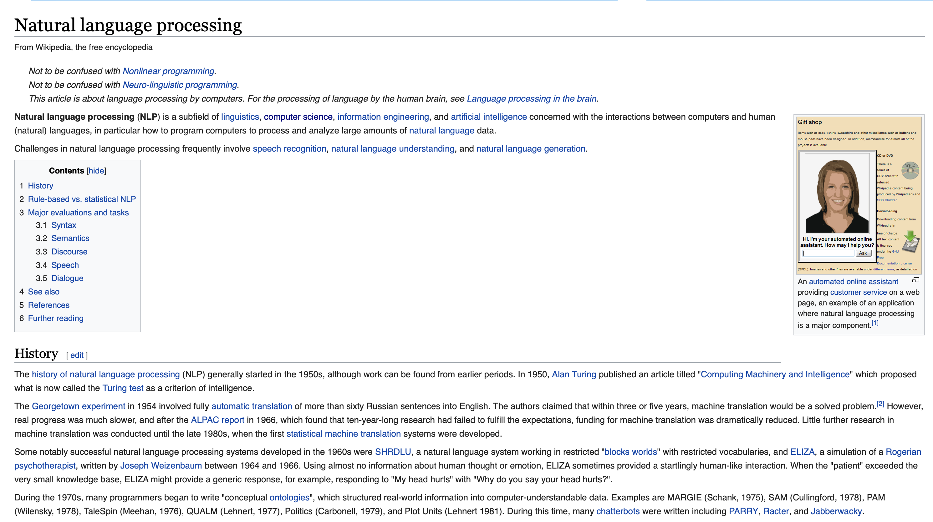
Learning Criteria
Section and Document Title (SDT)
Nesting Level (NL)
Sentence and Paragraph Position (SPP)

Slide 34
Learning Criteria
Our models are built upon Skip-thought. All are trained with Neighboring Sentence Prediction (NSP).
Models are trained to reconstruct bag-of-words representations of target sequences in NSP and SDT.

Slide 35
Experiments – Benchmark proposed learning objectives on DiscoEval

Slide 36
Experiments – Benchmark proposed learning objectives on DiscoEval
SPP+NL gives the strongest performance compared to other combinations.

Slide 37
Experiments – Benchmark proposed learning objectives on DiscoEval
Simply adding all the losses is not optimal as some of them could be contradictory.

Slide 38
Conclusion
We introduce DiscoEval for evaluating discourse knowledge encoded in pretrained sentence representations, which is comprised of 7 task groups and covers multiple domains.
We also introduce a set of multi-task losses that make use of document structures for learning discourse-aware sentence representations.
Human evaluations show that humans still outperform BERT-Large by a large margin.

Slide 39

DiscoEval is available at https://github.com/ZeweiChu/DiscoEval
Thanks!

Slide 40
Human Evaluation
 | Sentence Position |  |  | Binary Sentence Ordering |  |  | Discourse Coherence
Human | 77.3 |  |  | 84.7 |  |  | 87.0
BERT-Large | 49.9 |  |  | 69.3 |  |  | 60.5
 | Wiki | arXiv | ROC | Wiki | arXiv | ROC | Wiki | Ubuntu
Human | 84.0 | 76.0 | 94.0 | 64.0 | 72.0 | 96.0 | 98.0 | 74.0
BERT-Large | 43.0 | 56.0 | 50.9 | 70.3 | 66.8 | 70.9 | 64.9 | 56.1
Human still outperforms BERT-Large by a large margin.

Slide 41
Discourse Relations – PDTB
PDTB provides a three-level hierarchy of relation tags. We use the second level of types, resulting in 12 categories for PDTB-E and 11 categories for PDTB-I.
We use a linear classifier and use the following as input
Where are the representations for the first and second sentence respectively.

Slide 42
Discourse Relations – PDTB
PDTB provides a three-level hierarchy of relation tags. We use the second level of types, resulting in 12 categories for PDTB-E and 11 categories for PDTB-I.
We use a linear classifier and use the following as input
Where are the representations for the first and second sentence respectively.

Slide 43
Discourse Relations – PDTB
PDTB provides a three-level hierarchy of relation tags. We use the second level of types, resulting in 12 categories for PDTB-E and 11 categories for PDTB-I.
We use a linear classifier and use the following as input
Where are the representations for the first and second sentence respectively.

Slide 44
Discourse Relations – PDTB
PDTB provides a three-level hierarchy of relation tags. We use the second level of types, resulting in 12 categories for PDTB-E and 11 categories for PDTB-I.
We use a linear classifier and use the following as input
Where are the representations for the first and second sentence respectively.

Slide 45
Sentence Position (SP)
We use a linear classifier and the input is
where is the representation for i-th sentence in the modified sequence.

Slide 46
Binary Sentence Ordering (BSO)
Similar to SP but focus more on local coherence.
Data source: Wikipedia article, ROC Stories corpus, and arXiv papers.
Binary prediction: predict if a pair of sentences is in the correct order.
Linear classifier with input as

Slide 47
Sentence Section Prediction (SSP)
Binary prediction: determine if the sentence is from the abstract section of a scientific writing.
Motivation: sentences within certain sections typically exhibit similar patterns because of the way people write coherent text.
Linear classifier and input is the sentence representation.
General
The theory behind the SVM and the naive Bayes classifier is explored.
This relocation of the active target may be repeated an arbitrary number of times.
Specific

